Slide 1






TOC
Compute-bound tasks
Task-based Combinators
I/O-bound tasks
Consuming the Task-based Asynchronous Pattern
Canceling an Asynchronous Operation
Monitoring Progress

Slide 2
Compute-bound tasks

Slide 3
Compute-bound tasks
Compute-bound tasks are those that heavily involve CPU calculations and computations, rather than waiting for external resources like I/O (input/output) operations. These tasks often consume significant CPU time, potentially leading to performance bottlenecks if not handled efficiently.

Slide 4
Compute-bound tasks
Key characteristics of compute-bound tasks:
CPU-intensive: They require the CPU to perform complex calculations or algorithms.
Minimal I/O: They don't involve frequent interactions with external resources like disks, networks, or databases.
Deterministic: Their execution time is primarily determined by the complexity of the computations and the CPU's processing power.

Slide 5
Examples of compute-bound tasks
Mathematical calculations:
Large matrix multiplications
Solving complex equations or systems of equations
Prime number generation
Cryptographic algorithms (e.g., encryption, decryption)
Data processing:
Image processing (e.g., filtering, resizing, compression)
Video encoding/decoding
Data analysis and visualization
Machine learning algorithms (e.g., training neural networks)
Scientific simulations:
Weather forecasting
Fluid dynamics simulations
Molecular dynamics simulations
Computational chemistry
Game development:
Physics simulations
AI calculations
Rendering complex graphics

Slide 6
I/O-bound tasks

Slide 7
I/O-bound tasks
I/O-bound tasks are those that are primarily limited by the speed of input/output (I/O) operations, such as reading from or writing to files, network communication, or database queries. These tasks often involve waiting for external resources, rather than intensive CPU calculations.

Slide 8
I/O-bound tasks
Key characteristics of I/O-bound tasks:
I/O-intensive: They heavily rely on interactions with external resources.
CPU-light: They typically don't require significant CPU processing power.
Non-deterministic: Their execution time can vary depending on factors like network latency, disk seek time, and database load.

Slide 9
Examples of I/O-bound tasks
File operations:
Reading large files
Writing data to files
Copying or moving files
Network communication:
Making HTTP requests
Downloading or uploading files
Real-time communication (e.g., chat applications)
Database interactions:
Querying large databases
Inserting, updating, or deleting data
Performing database transactions
Web scraping:
Fetching web pages
Parsing HTML content

Slide 10
Consuming the Task-based Asynchronous Pattern

Slide 11
Consuming the Task-based Asynchronous Pattern
Asynchronous Methods: Methods marked with async return Task objects, representing asynchronous operations.
Await Keyword: Used to pause the execution of an asynchronous method until a task completes, preventing blocking.

Slide 12
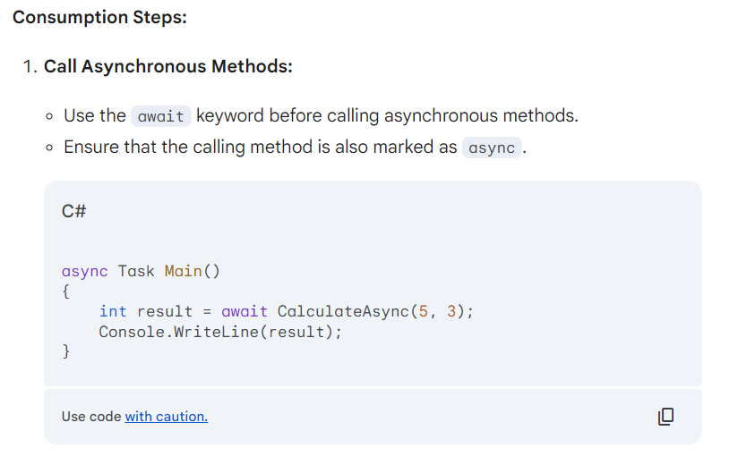
Consuming the Task-based Asynchronous Pattern

Slide 13
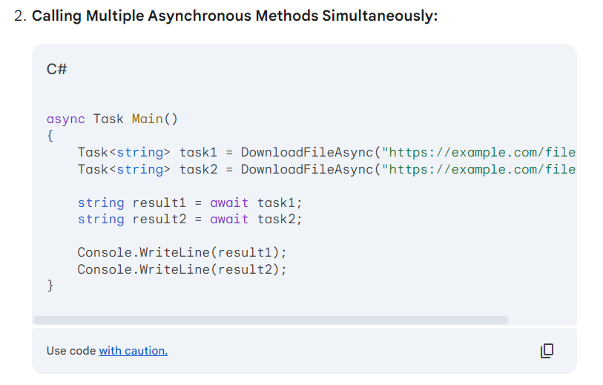
Consuming the Task-based Asynchronous Pattern

Slide 14
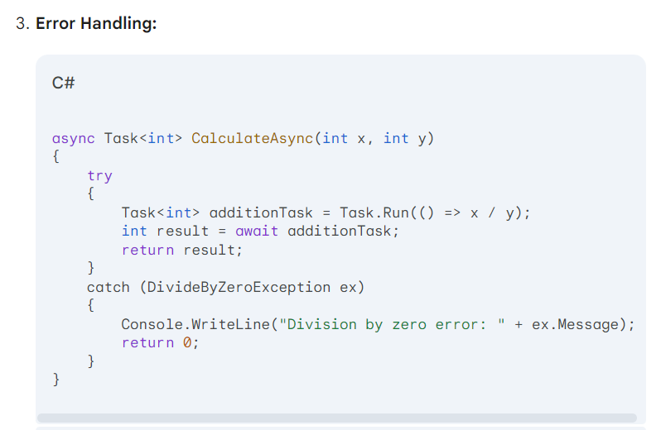
Consuming the Task-based Asynchronous Pattern

Slide 15
Configuring Suspension and Resumption with Yield and ConfigureAwait
yield Keyword:
Used to create iterators, which allow methods to return sequences of values one at a time.
Can be used to suspend and resume execution within asynchronous methods.

Slide 16
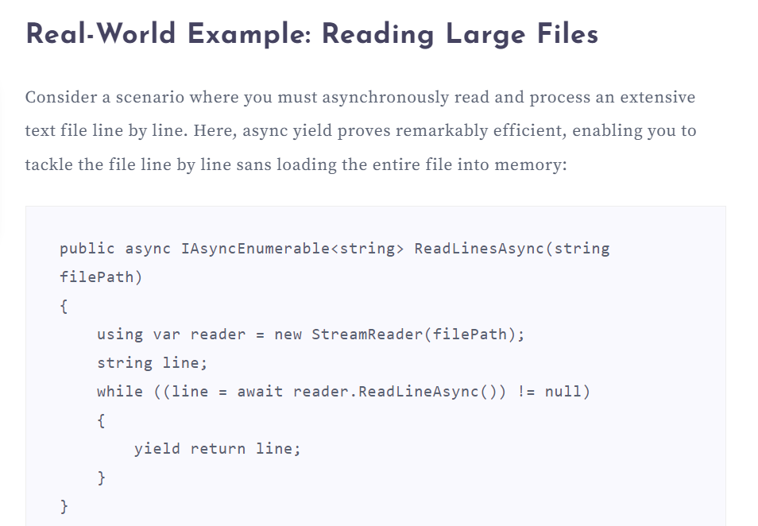

Slide 17
ConfigureAwait
Understanding ConfigureAwait
Purpose: The ConfigureAwait(false) method is used to control the context in which a task continues execution after being awaited.
Behavior: By default, a task continues execution on the same thread that awaited it. Using ConfigureAwait(false) allows a task to continue execution on a different thread pool thread.

Slide 18
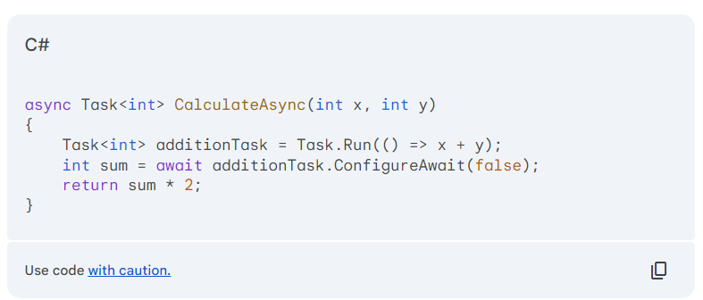
ConfigureAwait

Slide 19
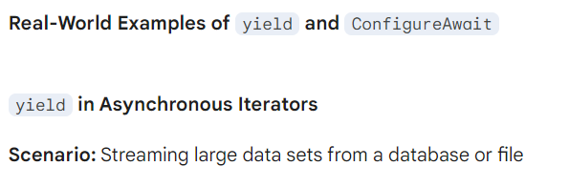
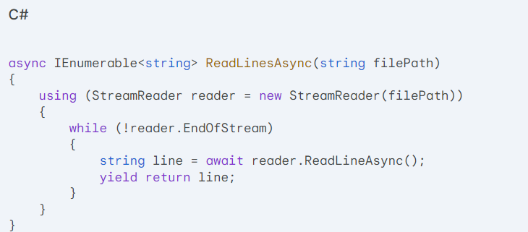
ConfigureAwait

Slide 20
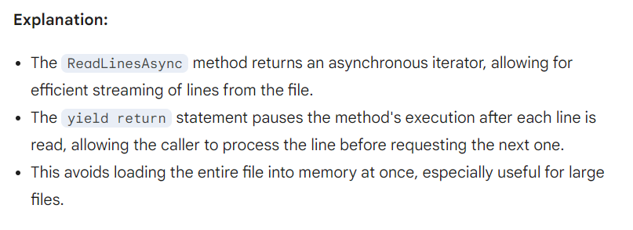
yield

Slide 21
yield and ConfigureAwait
Combining yield and ConfigureAwait(false)
Scenario: Streaming data from a web API while performing asynchronous operations

Slide 22
yield and ConfigureAwait
async IEnumerable<string> FetchDataAsync(string url)
{
using (HttpClient client = new HttpClient())
{
HttpResponseMessage response = await client.GetAsync(url);
response.EnsureSuccessStatusCode();
using (StreamReader reader = new StreamReader(await response.Content.ReadAsStreamAsync()))
{
while (!reader.EndOfStream)
{
string line = await reader.ReadLineAsync().ConfigureAwait(false);
yield return line;
}
}
}
}

Slide 23
yield and ConfigureAwait
Without ConfigureAwait:
By default, when a task completes and is awaited, the continuation of the code (the part that follows the await keyword) is executed on the same thread that awaited the task.
This behavior can be useful in some scenarios, especially when you want to ensure that certain code runs on a specific thread.

Slide 24
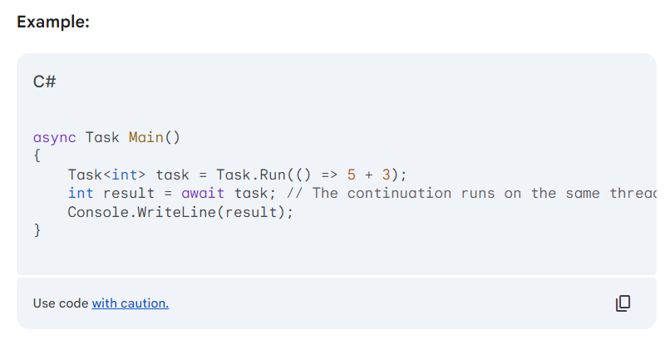
yield and ConfigureAwait

Slide 25
yield and ConfigureAwait
With ConfigureAwait(false)
Using ConfigureAwait(false) after an await expression tells the task to continue its execution on a different thread pool thread, rather than the original thread.
This can be beneficial in scenarios where you want to avoid unnecessary context switches between threads, potentially improving performance.

Slide 26
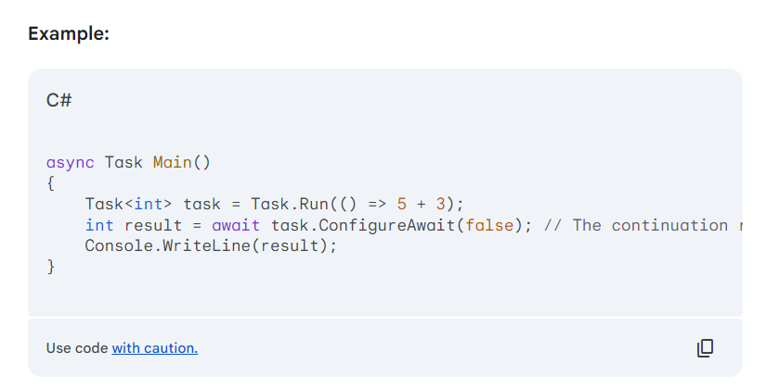
yield and ConfigureAwait

Slide 27
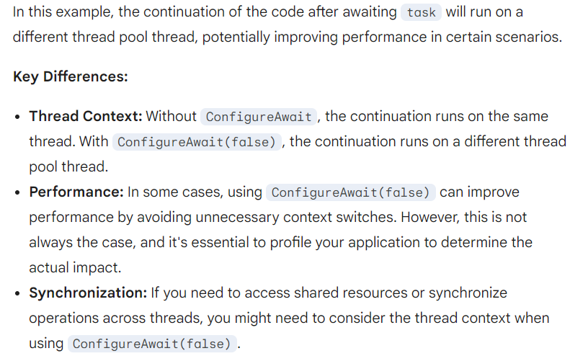
yield and ConfigureAwait

Slide 28
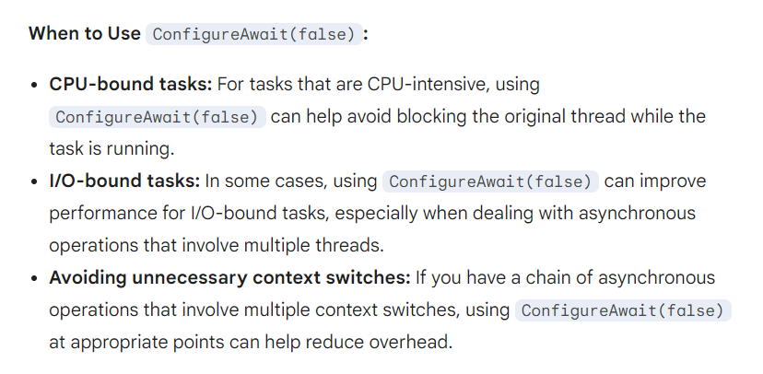
yield and ConfigureAwait

Slide 29
Canceling an Asynchronous Operation

Slide 30
Understanding Cancellation:
Cancellation Tokens: Used to signal cancellation requests to asynchronous operations.
CancellationTokenSource: Creates and manages cancellation tokens.
Cancellation Exceptions: Thrown when a cancellation token is signaled.

Slide 31
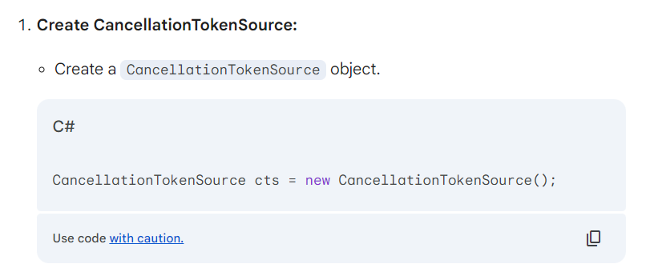

Slide 32
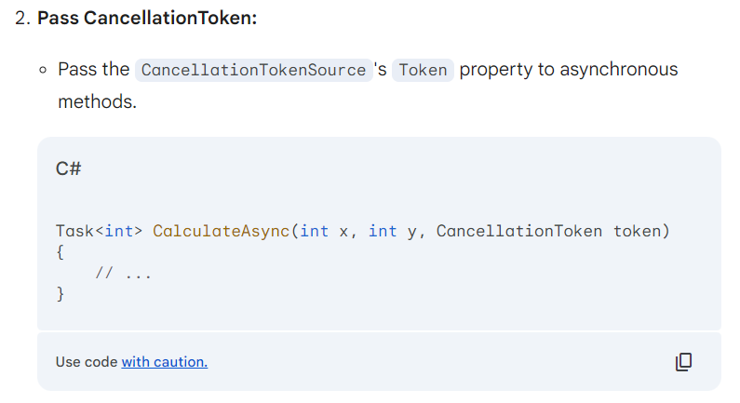

Slide 33
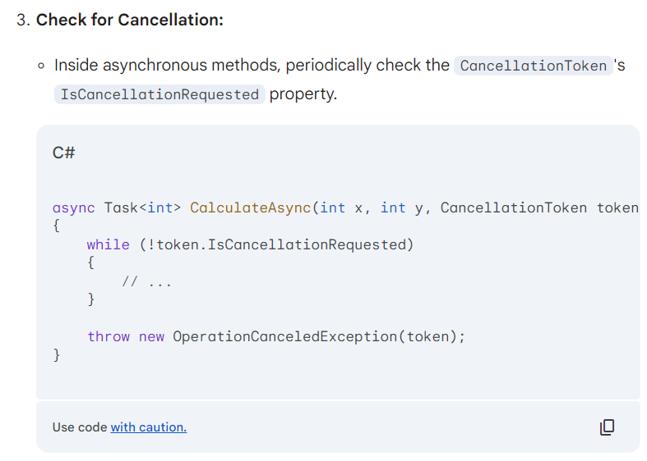

Slide 34
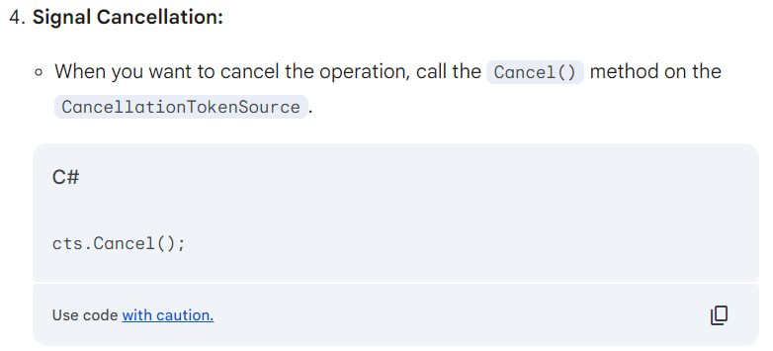

Slide 35
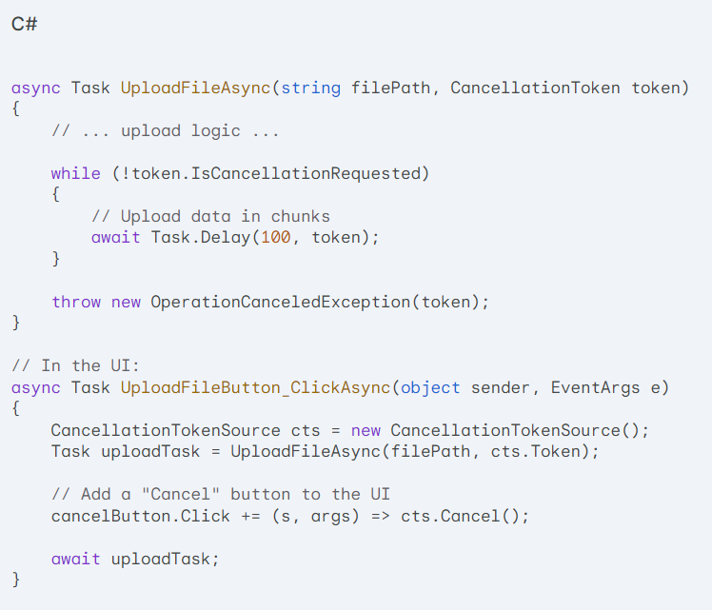
User-Initiated Cancellation
Scenario: A user wants to cancel a long-running file upload process.

Slide 36
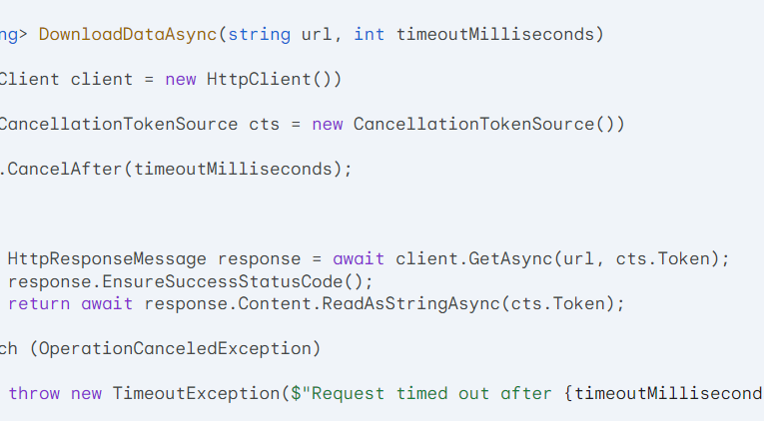
Timeout-Based Cancellation
Scenario: A web request times out after a certain duration.

Slide 37
Monitoring Progress

Slide 38
Understanding Progress Monitoring
Progress Reporting: Involves providing updates on the progress of an asynchronous operation.
Progress Indicators: Visual elements like progress bars, percentage values, or status messages.
Progress Reporting Patterns:
Periodic Updates: Report progress at regular intervals.
Event-Based Updates: Raise events when progress changes.
Callback Functions: Provide callback functions to be executed when progress changes.

Slide 39
Real-World Examples:
File Downloads: Report progress as bytes are downloaded.
Large Data Processing: Show progress based on the number of items processed or the percentage of data analyzed.
Long-Running Tasks: Provide updates on the task's duration or completion percentage.

Slide 40
Task-based Combinators

Slide 41
Redundancy combinator
Purpose: Used to execute multiple tasks concurrently and return the result of the first task that completes successfully.
Benefits:
Increased resilience to failures.
Improved performance in certain scenarios.
Simplified asynchronous programming.

Slide 42
Redundancy combinator
Purpose: Used to execute multiple tasks concurrently and return the result of the first task that completes successfully.
Benefits:
Increased resilience to failures.
Improved performance in certain scenarios.
Simplified asynchronous programming.

Slide 43
Redundancy combinator
Implementation:
Create Multiple Tasks:
Create multiple tasks that perform the same operation.
Use Task.WhenAny:
Use Task.WhenAny to wait for the first task to complete.
Handle Results:
If the first task completes successfully, return its result.
If the first task fails, handle the exception and continue waiting for other tasks.

Slide 44
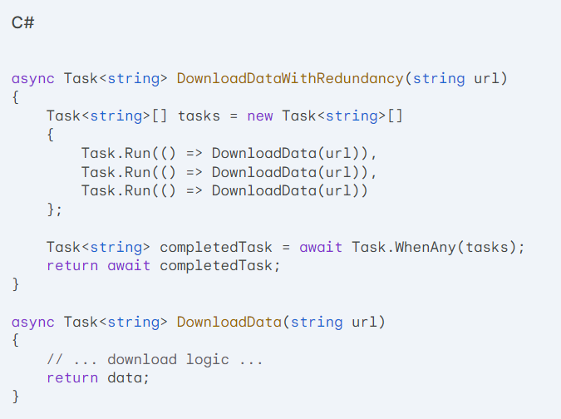
Redundancy combinator

Slide 45
Redundancy combinator
Explanation
The DownloadDataWithRedundancy method creates three tasks that download data from the same URL.
Task.WhenAny waits for the first task to complete.
If the first task succeeds, its result is returned. If it fails, the other tasks continue executing.
This approach increases resilience to failures, as if one download fails, the others can still succeed.

Slide 46
Interleaving combinator
Explanation
The DownloadDataWithRedundancy method creates three tasks that download data from the same URL.
Task.WhenAny waits for the first task to complete.
If the first task succeeds, its result is returned. If it fails, the other tasks continue executing.
This approach increases resilience to failures, as if one download fails, the others can still succeed.

Slide 47
Interleaving combinator
Understanding Interleaving:
Core Concept: Interleaving refers to the execution of multiple asynchronous operations in an alternating or interspersed manner, rather than waiting for one to complete before starting the next.
Benefits:
Improved responsiveness and performance.
Efficient utilization of resources.
Enhanced user experience.

Slide 48
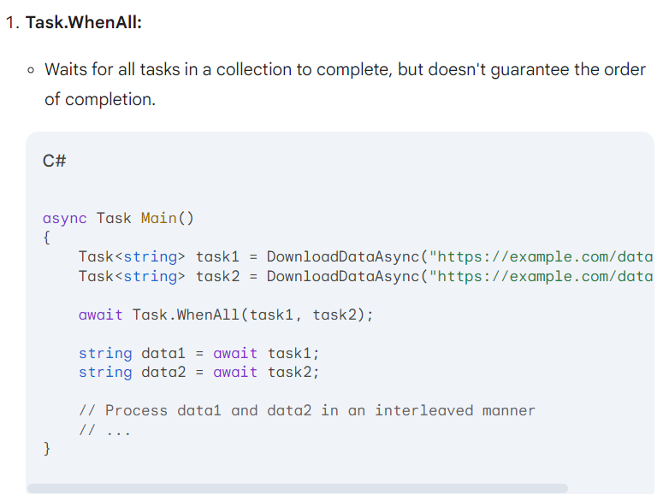
Interleaving combinator

Slide 49
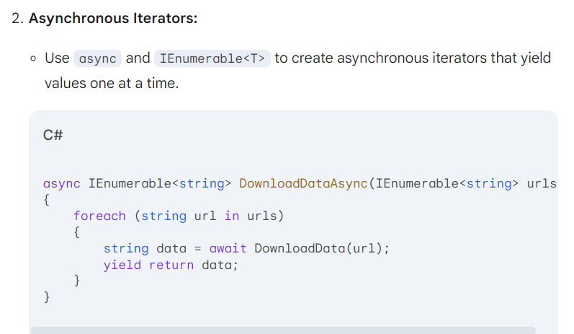
Interleaving combinator

Slide 50
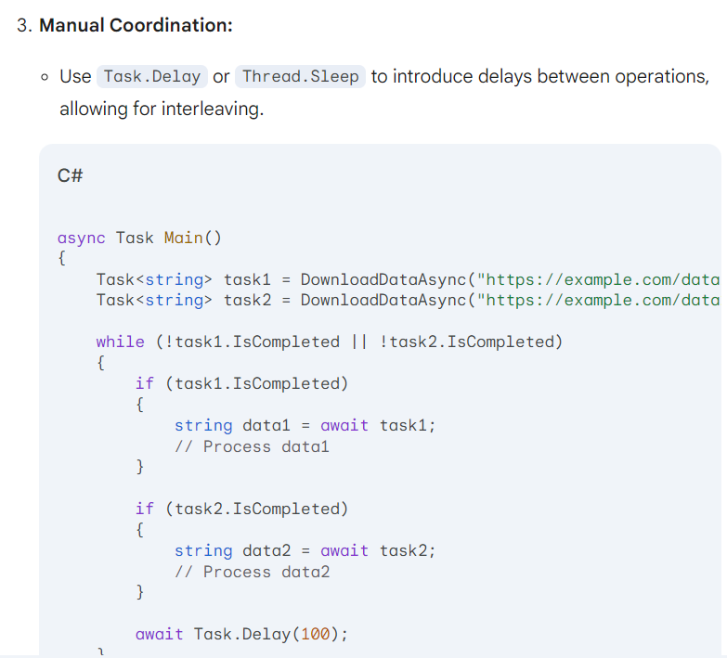
Interleaving combinator

Slide 51
Real-World Examples:
Parallel Data Processing: Process multiple data streams or files concurrently.
Web Scraping: Fetch data from multiple web pages simultaneously.
Asynchronous I/O: Perform multiple I/O operations concurrently (e.g., reading from multiple files or sockets).

